Slide 1


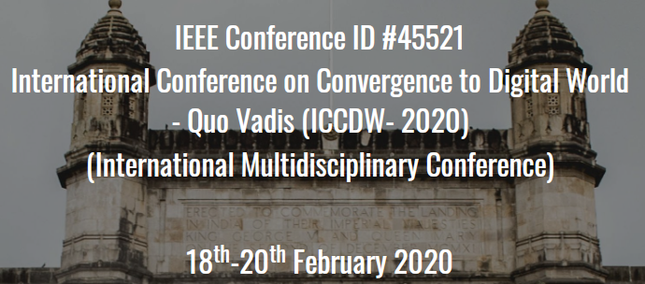
 | ATHARVA EDUCATIONAL TRUST'S ATHARVA COLLEGE OF ENGINEERING
 | (Approved by AICTE, Recognized by Government of Maharashtra & Affiliated to University of Mumbai - Estd. 1999 - 2000)
Paper Id / Submission Id :____
Paper id (easychair id):___ | Author s Name :
Institute Name: | A.P. Shah Institute of Technology
Presentation given by: | Sameer Dev
Paper Title: | Voice Enabled Smart Assistive Device for the Visually Challenged
PDFeXpID: | PDFeXpID6366025
2020, International Conference on Convergence to Digital World – Quo Vadis (ICCDW 2020)

Slide 2
PRESENTATION FLOW
Abstract
Problem Definition/ Objective
Introduction
Literature Survey
Theory (Proposed work/Implementation/Algorithm etc.)
Results and Discussions
Conclusion/Future Scope
References
Date: 20-02-2020
Date: 20-02-2020
2020, International Conference on Convergence to Digital World – Quo Vadis (ICCDW 2020)
2020, International Conference on Convergence to Digital World – Quo Vadis (ICCDW 2020)

Slide 3
ABSTRACT
The World Health Organization (WHO) Fact reported that there are 285 million visually-impaired people worldwide. Among these individuals, there are 39 million who are blind in the world. Unfortunately, all these numbers are estimated to be doubled by 2020.
In this high tech era, technology has made it possible for everyone to live a comfortable life. But somehow the physically challenged people need to depend upon others in their daily life which ultimately makes them less confident in an unfamiliar environment.
So, in this project, an intelligent device is represented, which is an amalgamation of various technologies, for the visually challenged people to help them travel around the college and similar premises safely without facing any difficulties and needing human help.
Date: 20-02-2020
2020, International Conference on Convergence to Digital World – Quo Vadis (ICCDW 2020)

Slide 4
PROBLEM DEFINITION
To create an assistive device for visually impaired people which will let them get a better sense of the surroundings and environment of our college and similar premises and also give them audio feedback regarding the obstacles. The device can also classify the nearby objects and give a basic idea to the user about the object either by voice commands. The device can be fully operated by voice commands for easy usage.
Date: 20-02-2020
2020, International Conference on Convergence to Digital World – Quo Vadis (ICCDW 2020)

Slide 5
OBJECTIVES
Build a device for travelling safely around the campus
Overcome Environmental Challenges
Overcome Technological Challenges
Overcome Social Challenges
Date: 20-02-2020
2020, International Conference on Convergence to Digital World – Quo Vadis (ICCDW 2020)

Slide 6

INTRODUCTION
In our project we present the modeling, implementation
and testing of an experimental microcontroller(MCU)
based smart assistive system which can be used by
the visually impaired.
This device includes audio feedback options
An easy to use Android App will also help the user set up the device during its
first run or else the device will run using its default settings as it would be
capable to work independently without requiring a smartphone to operate.
Date: 20-02-2020
2020, International Conference on Convergence to Digital World – Quo Vadis (ICCDW 2020)

Slide 7
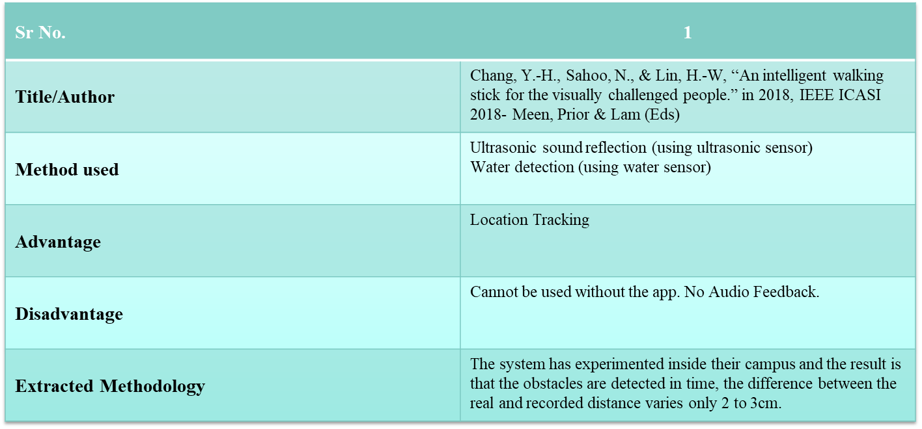
Literature Survey
Date: 20-02-2020
2020, International Conference on Convergence to Digital World – Quo Vadis (ICCDW 2020)

Slide 8
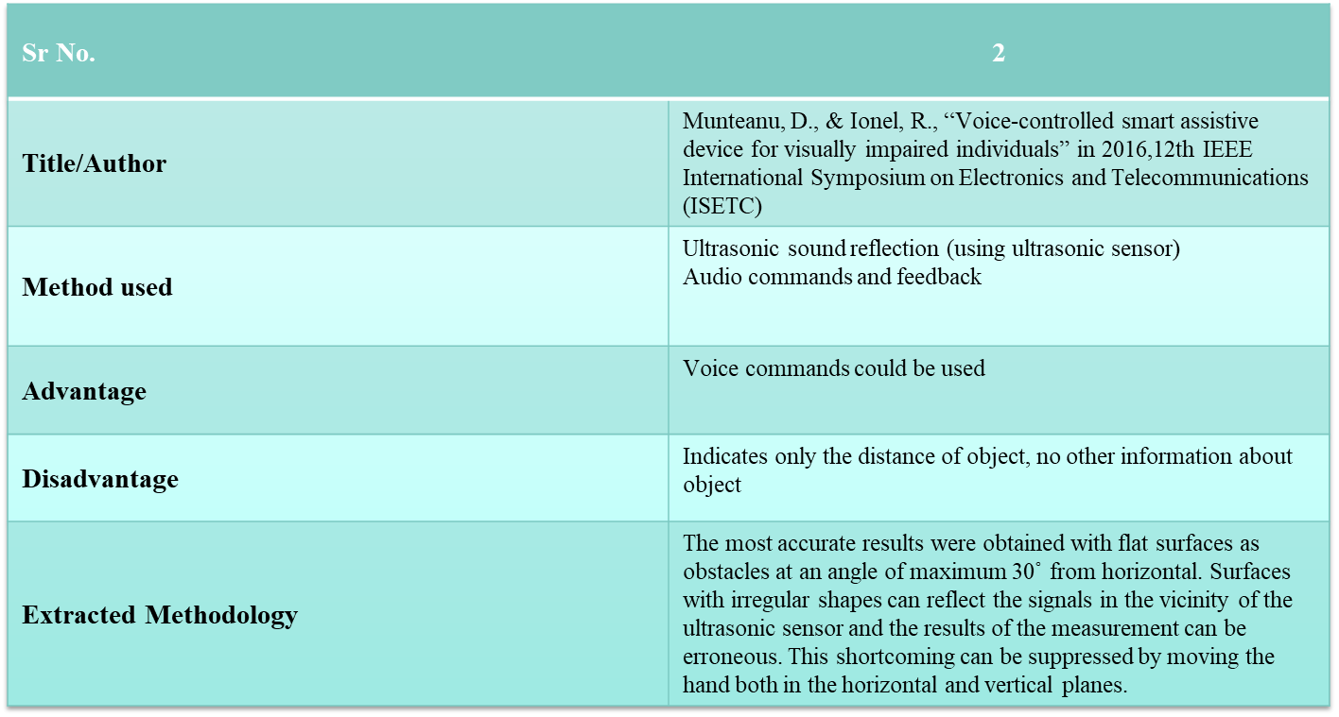
Date: 20-02-2020
2020, International Conference on Convergence to Digital World – Quo Vadis (ICCDW 2020)

Slide 9
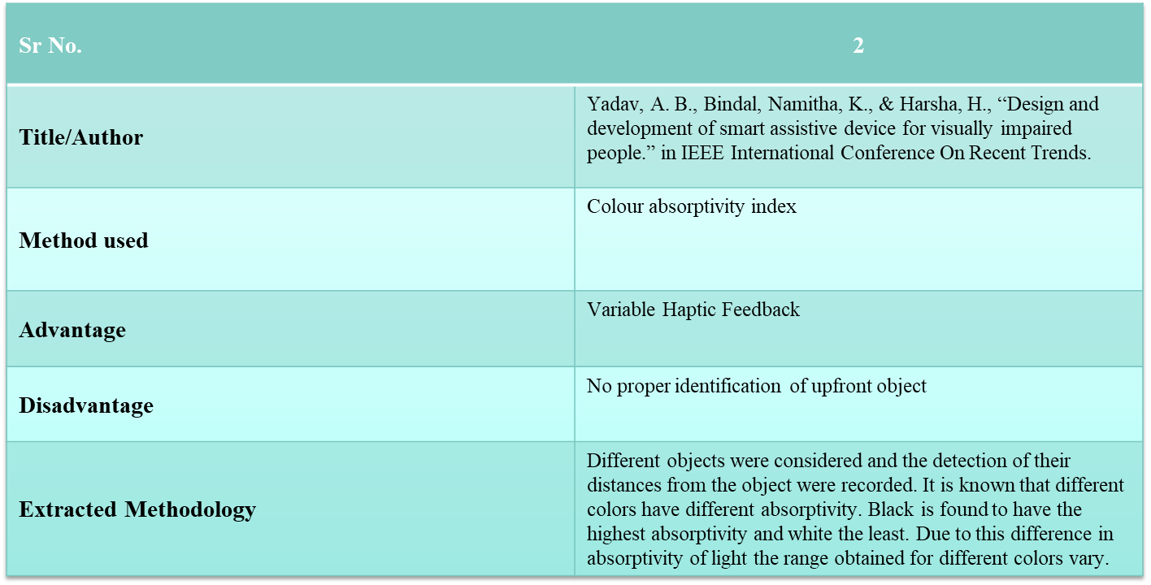
Date: 20-02-2020
2020, International Conference on Convergence to Digital World – Quo Vadis (ICCDW 2020)

Slide 10
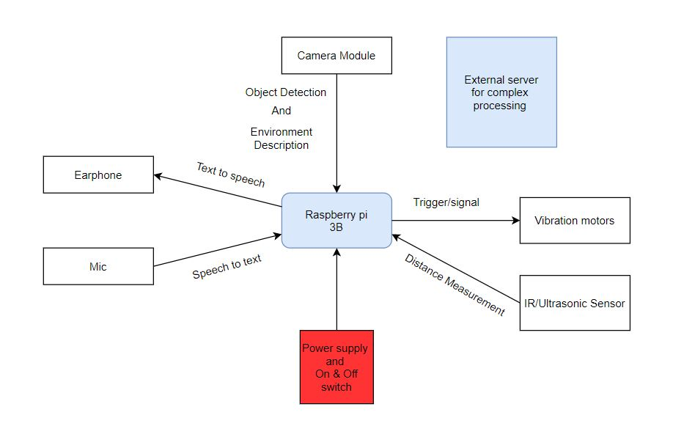
PROPOSED SYSTEM
Date: 20-02-2020
2020, International Conference on Convergence to Digital World – Quo Vadis (ICCDW 2020)

Slide 11
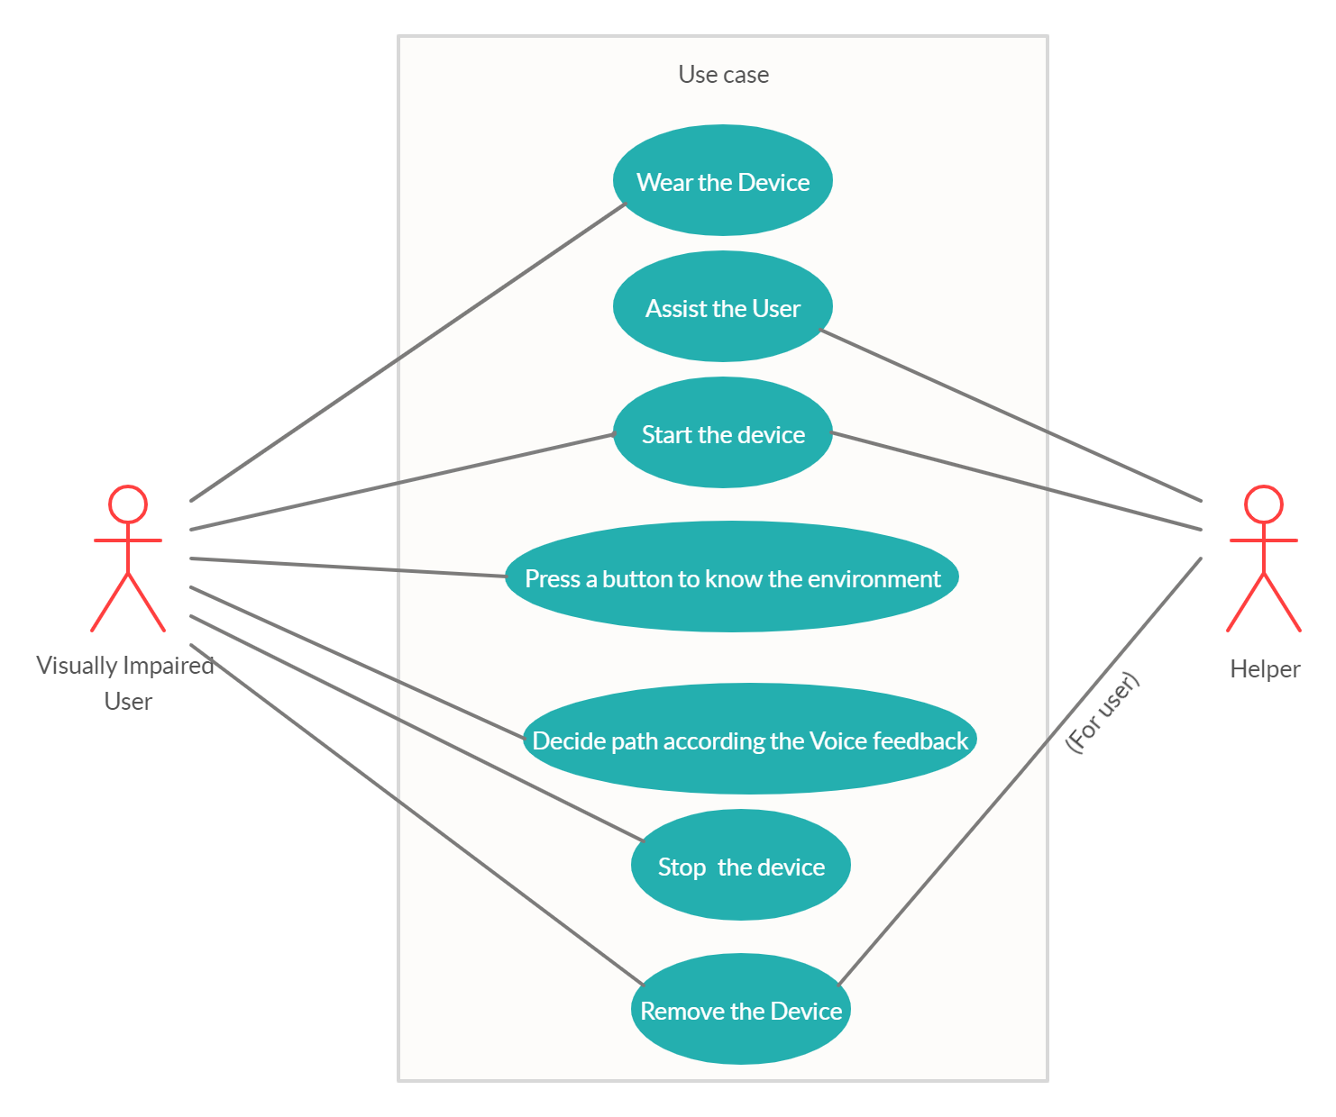
Design(Flow Of Modules)
Date: 20-02-2020
2020, International Conference on Convergence to Digital World – Quo Vadis (ICCDW 2020)

Slide 12
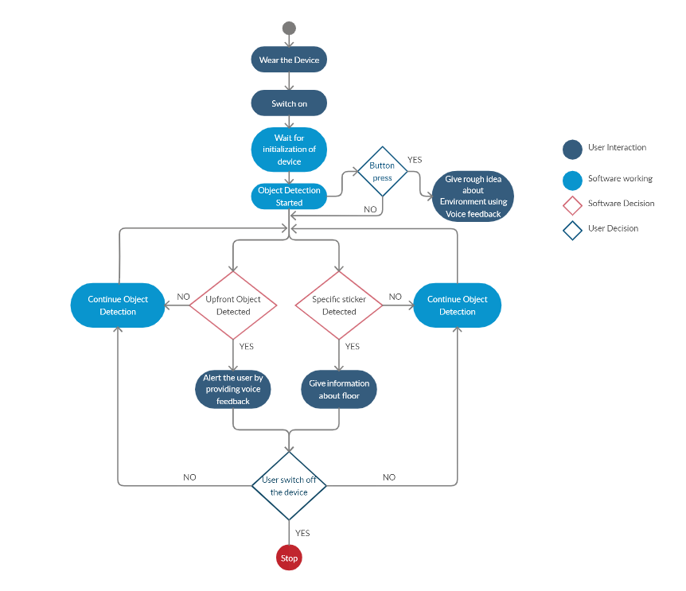
ACTIVITY DIAGRAM
Date: 20-02-2020
2020, International Conference on Convergence to Digital World – Quo Vadis (ICCDW 2020)

Slide 13
RESULTS AND DISCUSSION
On being tested in the campus we found that the device was capable of giving near real time information to the user regarding all the obstacles in his/her path
It could also determine the orientation (left/right) of the detected object which was a huge help for the user
The Environment Description Module, trained on only 8000 images available in the Flickr8K dataset, worked decently and could work even better if trained on a larger dataset
Date: 20-02-2020
2020, International Conference on Convergence to Digital World – Quo Vadis (ICCDW 2020)

Slide 14
CONCLUSION/SCOPE
The device will make the use of various technologies in order to create a single device capable of assisting the huge number of people in need.
The device will be making real time predictions without any human help, it will be an added benefit as the people using this device will be able to walk around the campus without any external human help.
Date: 20-02-2020
2020, International Conference on Convergence to Digital World – Quo Vadis (ICCDW 2020)

Slide 15
POSSIBLE FUTURE ADDITIONS
The primary language currently is English but we can also add language support for Hindi and Marathi
Implement this solution for areas other than our campus
Date: 20-02-2020
2020, International Conference on Convergence to Digital World – Quo Vadis (ICCDW 2020)

Slide 16
REFERENCES
[1] Chang, Y.-H., Sahoo, N., & Lin, H.-W. (2018). An intelligent walking stick for the visually challenged people. 2018 IEEE International Conference on Applied System Invention (ICASI)
[2] Yadav, A. B., Bindal, L., Namhakumar, V. U., Namitha, K., & Harsha, H. (2016). Design and development of smart assistive device for visually impaired people. 2016 IEEE International Conference on Recent Trends in Electronics, Information & Communication Technology (RTEICT)
[3] Munteanu, D., & Ionel, R. (2016). Voice-controlled smart assistive device for visually impaired individuals. 2016 12th IEEE International Symposium on Electronics and Telecommunications (ISETC)
[4] Agarwal, R., Ladha, N., Agarwal, M., Majee, K. K., Das, A., Kumar, S., Saha, H. N. (2017). Low cost ultrasonic smart glasses for blind. 2017 8th IEEE Annual Information Technology, Electronics and Mobile Communication Conference (IEMCON)
[5] Lee, C.-N., Chu, Y.-T., Cheng, L., Lin, Y.-T., & Lan, K.-F. (2017). Blind assistive device - Smart Lazy Susan. 2017 International Conference on Machine Learning and Cybernetics (ICMLC)
Date: 20-02-2020
2020, International Conference on Convergence to Digital World – Quo Vadis (ICCDW 2020)

Slide 17
REFERENCES
[6] Kasthuri, R., Nivetha, B., Shabana, S., Veluchamy, M., & Sivakumar, S. (2017). Smart device for visually impaired people. 2017 Third International Conference on Science Technology Engineering & Management (ICONSTEM)
[7] Karpathy, A., & Fei-Fei, L. (2015). Deep visual-semantic alignments for generating image descriptions. 2015 IEEE Conference on Computer Vision and Pattern Recognition (CVPR)
[8] Patil, P., & Sonawane, A. (2017). Environment sniffing smart portable assistive device for visually impaired individuals. 2017 International Conference on Trends in Electronics and Informatics (ICEI)
[9] Pawluk, D. T. V., Adams, R. J., & Kitada, R. (2015). Designing Haptic Assistive Technology for Individuals Who Are Blind or Visually Impaired. IEEE Transactions on Haptics, 8(3), 258–278.
[10] Aymaz, S., & Cavdar, T. (2016). Ultrasonic Assistive Headset for visually impaired people. 2016 39th International Conference on Telecommunications and Signal Processing (TSP).
Date: 20-02-2020
2020, International Conference on Convergence to Digital World – Quo Vadis (ICCDW 2020)

